Slide 1


welcome

Slide 2
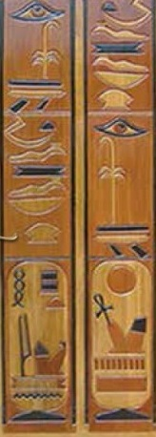
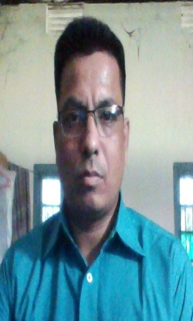
Teacher’s identity
English grammar
Class: nine
Unit 9: lesson 3
Time 50 minutes
Student: 50
Bichitro kumer singha
Assistant teacher
Zakigonj govt. high school
Zakigonj, sylhet.
Phone: 01717649381

Slide 3
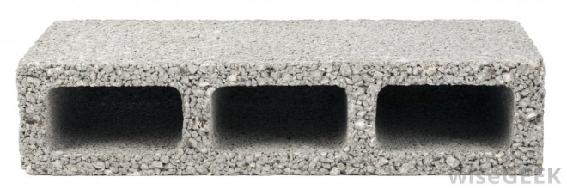
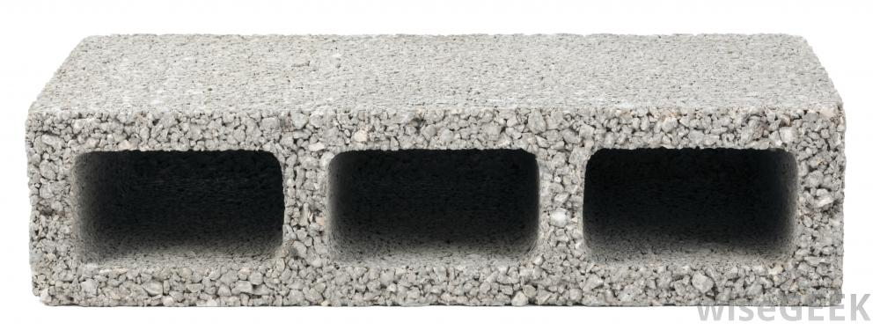
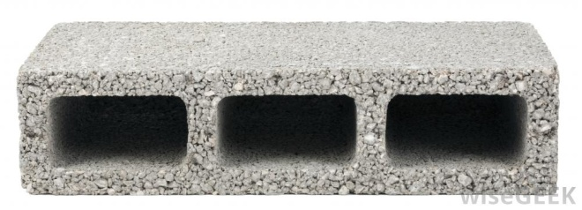
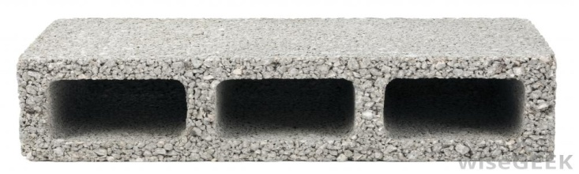
wall
Block
Blocks make the wall.

Slide 4
makes
blocks
makes
the wall.
At last what have you seen above ?
Ans: a sentence

Slide 5
Text declare:
sentence
After completing the text, students
will be able to
1. Make sentence.
2. Classifications of Sentence according to structure

Slide 6

The student reads the book
subject
Verb
object

Slide 7


Look at the picture and make sentence.
He goes to school.
They use computer.

Slide 8
sentence
simple
complex
compound

Slide 9
Jkalok goes to school everyday.
Jhalok
goes
one clause
One subject
one finite verb

Slide 10
Identify simple sentence
1. We know when he will come.
2. Nadia is in class none.
3. He is poor but honest.
Can you say why the statement is
simple sentence ?
The statement has one subject, one
verb and one clause is called simple sentence.

Slide 11

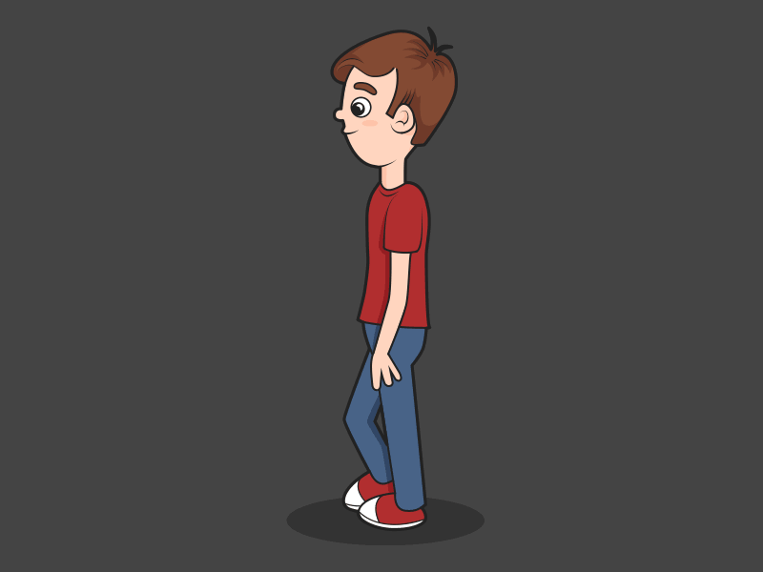
While he walked along the road, it started raining.

Slide 12
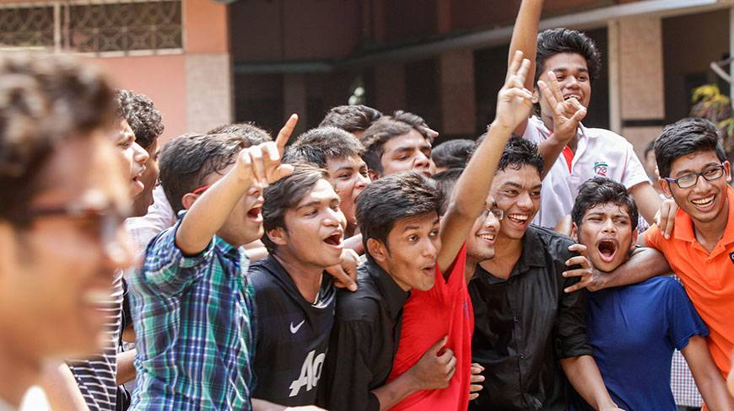
If
you read more,
You will pass the exam

Slide 13
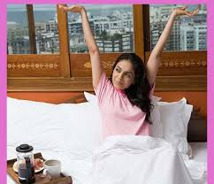

You arise early
So that
You get enough
time to study
Principal clause
Sub-ordinate clause

Slide 14
Identify complex sentence.
Returning from school, they play
in the lawn.
2. Read regularly or you will not
pass the examination.
3. Tell me how you did it.
Can you say why the statement is
complex sentence ?
The statement has one principal
clause and one sub-ordinate clause.

Slide 15
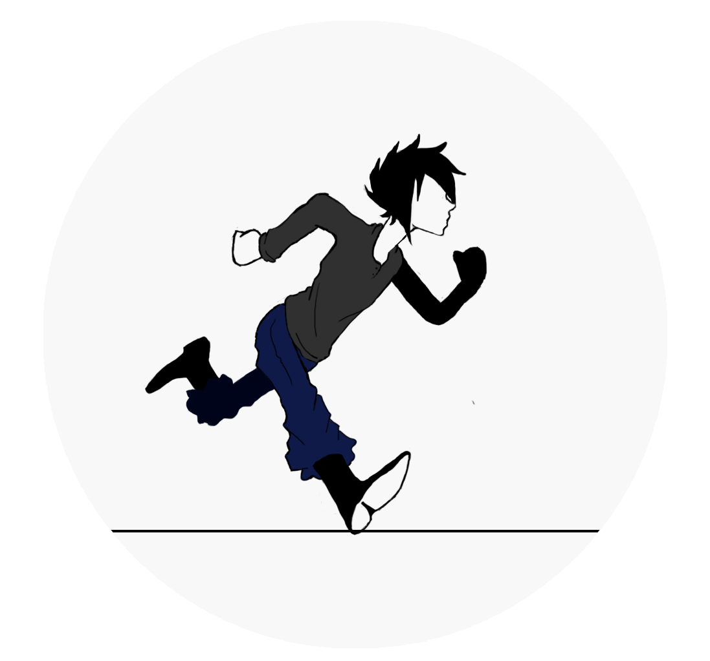

Run fast
and
You will win the prize

Slide 16
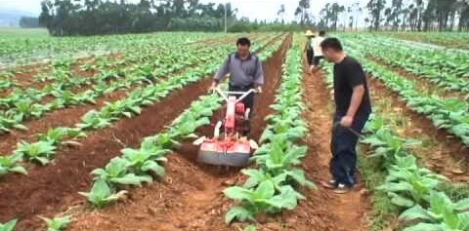
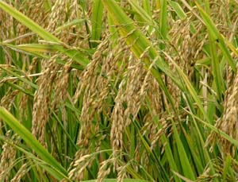
Use modern
instrument
you will get enough
crops.
and
Principal clause
Co-ordinate clause

Slide 17
Identify compound sentence.
If you read regularly, you will
pass the examination.
2. Read regularly and you will pass
the examination.
3. They like to play after school.
Can you say why the statement is
compound sentence ?
The statement has one or more
co-ordinate clause.

Slide 18
Evalution: Identify the sentences
simple,complex or compound.
1. A studious boy can shine in life.
Simple.
2. He is good boy and he will be
rewarded.
Compound .
Complex .
3. If you solve the problem, you will
lead a happy life.
4. Without working hard. you can
not shine in life.
Simple .

Slide 19
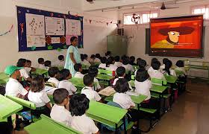
Home work: using the
pictures, make a simple,
a complex and a
Compound sentence.

Slide 20

Thanks all

